Slide 1
Faster Addition

Slide 2
Faster addition
Determining the carry n sooner => speeding up
Fewer gates in sequence but many more gates
Worse case scenario is a function of log₂^{n}
Unlike software, hardware executes I parallel whenever inputs change

Slide 3




Fast Carry Using infinite Hardware
carryIn for bit2 is CarryOut of bit 1

Slide 4

Fast Carry: Propagation, Generation
Limit the complexity of the equation to simplify the hardware
C2 = (a1.b1) + (a1+b1).((a0.b0) + (a0+b0).c0)
ai.bi generate(gi) and (ai+bi) propagate(pi)

Slide 5




Fast Carry: Propagation, Generation

Slide 6
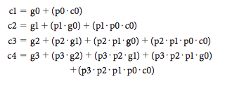
Fast Carry: Propagation, Generation

Slide 7

Fast Carry: Second Level Abstraction
Perform carry look ahead for 4-bit adders
Super propagate

Slide 8
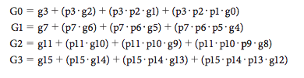
Fast Carry: Second Level Abstraction
Perform carry look ahead for 4-bit adders
Super generate

Slide 9
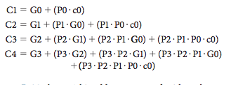
Fast Carry: Second Level Abstraction
Perform carry look ahead for 4-bit adders
Carry

Slide 10
Performance
Carry look ahead vs Ripple Carry
Time: counting the number of gates along the path
Performance for two 16-bits adders
Using tipple carry = 16*2 = 32
Using two-level carry look ahead = 2 + 2 + 1

Slide 11
What we have covered?
Appendix B.6

